Slide 1
COVID vaccine overview
What you need to know
Name Here, followed by credentials
Slides adapted from Centers for Disease Control and Prevention and the Oregon Health Authority

Slide 2
About me
Add info here
Add info here.
Add info here.
Add presenter name here
Add presenter title here

Slide 3
What we’ll cover today
Overview of COVID-19 and importance of vaccination
COVID-19 vaccines:
  – How they were developed
  – What you need to know about these safe, effective vaccines
  – Myth busting: Common concerns about vaccine safety and facts to know
Discussion

Slide 4

Overview of COVID-19 +
Importance of Vaccination

Slide 5

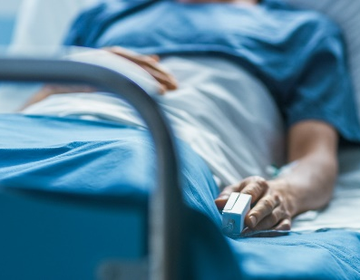
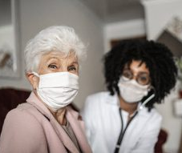
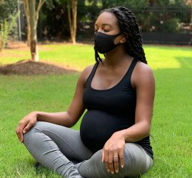

What is known about COVID-19?
COVID-19 and Vaccine Basics
Infection with SARS-CoV-2, the virus that causes COVID-19, can result in a range of illness, from mild symptoms to severe illness and death.
We don’t know how SARS-CoV-2 will affect each person.
Some people, such as adults 65 and older or people with certain medical conditions, are more likely than others to become severely ill.
Notes:
It is known that infection with SARS-CoV-2, the virus that causes COVID-19, can result in a range of illnesses, from mild symptoms to severe illness and death. About 30% of persons infected with SARS-CoV-2 do not have symptoms. No one can predict how severe any person’s illness might be, but certain factors may increase your risk. Some people are more likely than others to become severely ill when infected, such as older adults or people with certain medical conditions, like diabetes, obesity, cancer, or heart disease.

Slide 6
COVID-19 Virus Variants
COVID-19 and Vaccine Basics
Viruses constantly change through mutation
Multiple variants of the virus that causes COVID-19 are circulating globally
So far, studies suggest that antibodies generated through vaccination with currently authorized vaccines recognize these variants. This is being closely investigated and more studies are underway.
Variant Name | First identified | Additional risk?
United Kingdom (UK) variant: B.1.1.7 | Identified in the UK in fall 2020 First detected in the US in December 2020 | May spread more easily May be associated with increased risk of death—additional study needed
South Africa variant: B.1.351 | Identified in October 2020 Cases caused by this variant reported in U.S. in January 2021
Brazil variant: P.1 | First detected in early-January 2021 Detected in U.S. in late-January 2021 | Mutations may affect its ability to be identified by antibodies
Source: https://www.cdc.gov/coronavirus/2019-ncov/transmission/variant.html
Last updated: 2/19/21
Notes:
It is known that infection with SARS-CoV-2, the virus that causes COVID-19, can result in a range of illnesses, from mild symptoms to severe illness and death. About 30% of persons infected with SARS-CoV-2 do not have symptoms. No one can predict how severe any person’s illness might be, but certain factors may increase your risk. Some people are more likely than others to become severely ill when infected, such as older adults or people with certain medical conditions, like diabetes, obesity, cancer, or heart disease.

Slide 7
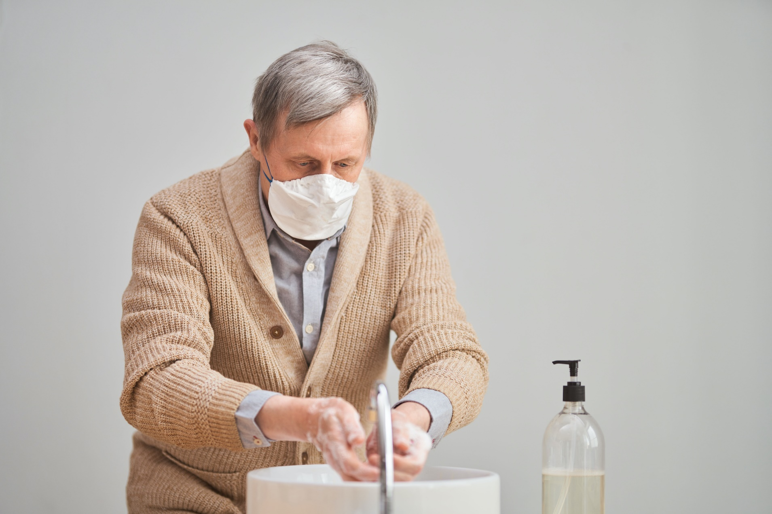
How to prevent COVID-19
COVID-19 and Vaccine Basics
Wear a mask that covers your mouth and nose.
Avoid close contact with others. Stay at least 6 feet (about 2 arm lengths) from other people.
Avoid crowds and poorly ventilated spaces.
Wash hands often with soap and water.
Use an alcohol-based hand sanitizer with at least 60% alcohol if soap and water are not available.
Avoid touching your eyes, nose, and mouth with unwashed hands.
Clean and disinfect frequently touched
surfaces daily.
Get a COVID-19 vaccine.

Slide 8
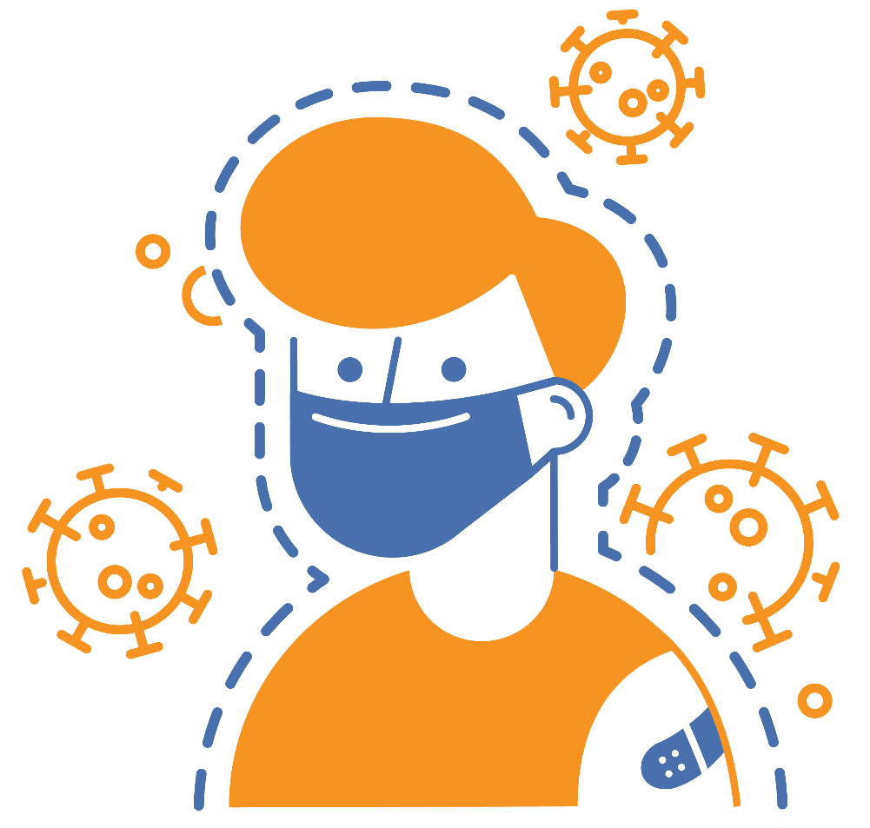
COVID-19 vaccination is a safer way to build protection
COVID-19 and Vaccine Basics
Getting the virus that causes COVID-19 may offer some natural protection, known as an antibody or immune. But experts don’t know how long this protection lasts.
The risk of severe illness and death from COVID-19 far outweighs any benefits of natural immunity.
COVID-19 vaccination will help protect you by building immunity without the risk of severe illness.
Notes:
COVID-19 vaccination is a safer way to help build protection. Getting the virus that causes COVID-19 may offer some natural protection, known as immunity. But experts don’t know how long this protection lasts, and the risk of severe illness and death from COVID-19 far outweighs any benefits of natural immunity. COVID-19 vaccination will help protect you.

Slide 9



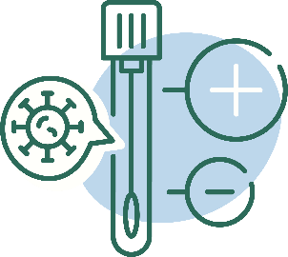
Key facts about COVID-19 vaccination
COVID-19 and Vaccine Basics
Getting vaccinated can help prevent getting sick with COVID-19
People who have already gotten sick with COVID-19 may still benefit from getting vaccinated
COVID-19 vaccines cannot give you COVID-19
COVID-19 vaccines will not cause you to test positive on COVID-19 viral tests*
https://www.cdc.gov/coronavirus/2019-ncov/vaccines/about-vaccines/vaccine-myths.html
*https://www.cdc.gov/coronavirus/2019-ncov/hcp/testing-overview.html
Notes:
It is easy to be confused by all the information that is circulating, some of which may be conflicting. CDC has facts to counteract common myths on this page, such as:
COVID-19 vaccines will not give you COVID-19
People who have gotten sick with COVID-19 may still benefit from getting vaccinated
Getting vaccinated can help prevent getting sick with COVID-19
COVID-19 vaccines will not cause you to test positive on COVID-19 viral tests*
Please visit: https://www.cdc.gov/coronavirus/2019-ncov/vaccines/about-vaccines/vaccine-myths.html to read more about these vaccine myths and the facts about COVID-19 vaccine from CDC.
NOTE: While COVID-19 vaccination will not cause a positive result on viral tests, there is a possibility that it could cause a positive result on a serologic (antibody) test.

Slide 10

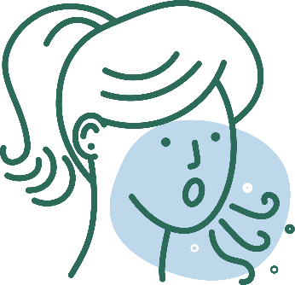
COVID-19 vaccination will help protect you from COVID-19
COVID-19 and Vaccine Basics
Getting a COVID-19 vaccine...
  Will help create an immune response in your body against the virus
  May help keep you from getting severely ill, even if you do get COVID-19
Notes:
COVID-19 vaccination will help keep you from getting COVID-19. Getting a COVID-19 vaccine will help create an immune response in your body against the virus without your having to experience illness. Based on what is known about vaccines for other diseases, experts believe that getting a COVID-19 vaccine may help keep you from getting seriously ill even if you do get COVID-19.

Slide 11
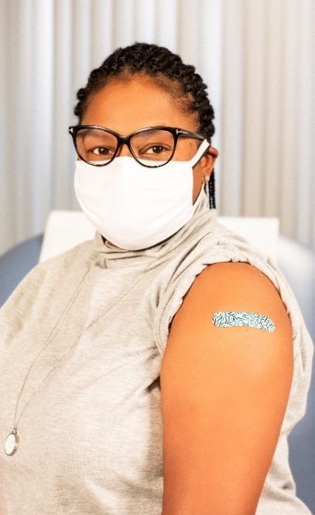
Vaccination is one measure to help stop the pandemic
COVID-19 and Vaccine Basics
While COVID-19 mRNA vaccines appear to be highly effective, additional preventive tools remain important to limit the spread of COVID-19.
The combination of getting vaccinated and following CDC recommendations to protect yourself and others offers the best protection from COVID-19.
  Cover your nose and mouth with a mask.
  Stay at least 6 feet from people who don’t live with you.
  Avoid crowds and poorly ventilated indoor spaces.
  Wash your hands.
Notes:
COVID-19 vaccination will be an important tool to help stop the pandemic, but it continues to be one tool in the toolbox. While COVID-19 mRNA vaccines appear to be highly effective, additional preventive tools remain important to limit the spread of COVID-19. The combination of getting vaccinated and following CDC’s recommendations to protect yourself and others will offer the best protection from COVID-19. Wash your hands. Avoid close contact. Cover your nose and mouth with a mask. Clean and disinfect frequently touched surfaces. Stopping a pandemic requires using all the tools we have available.
It will take time to vaccinate all people living in the United States. While the vaccines are being delivered, it's important that everyone continue to take all steps (wear a mask, avoid close contact with others, and wash your hands) to prevent spread of COVID-19.

Slide 12
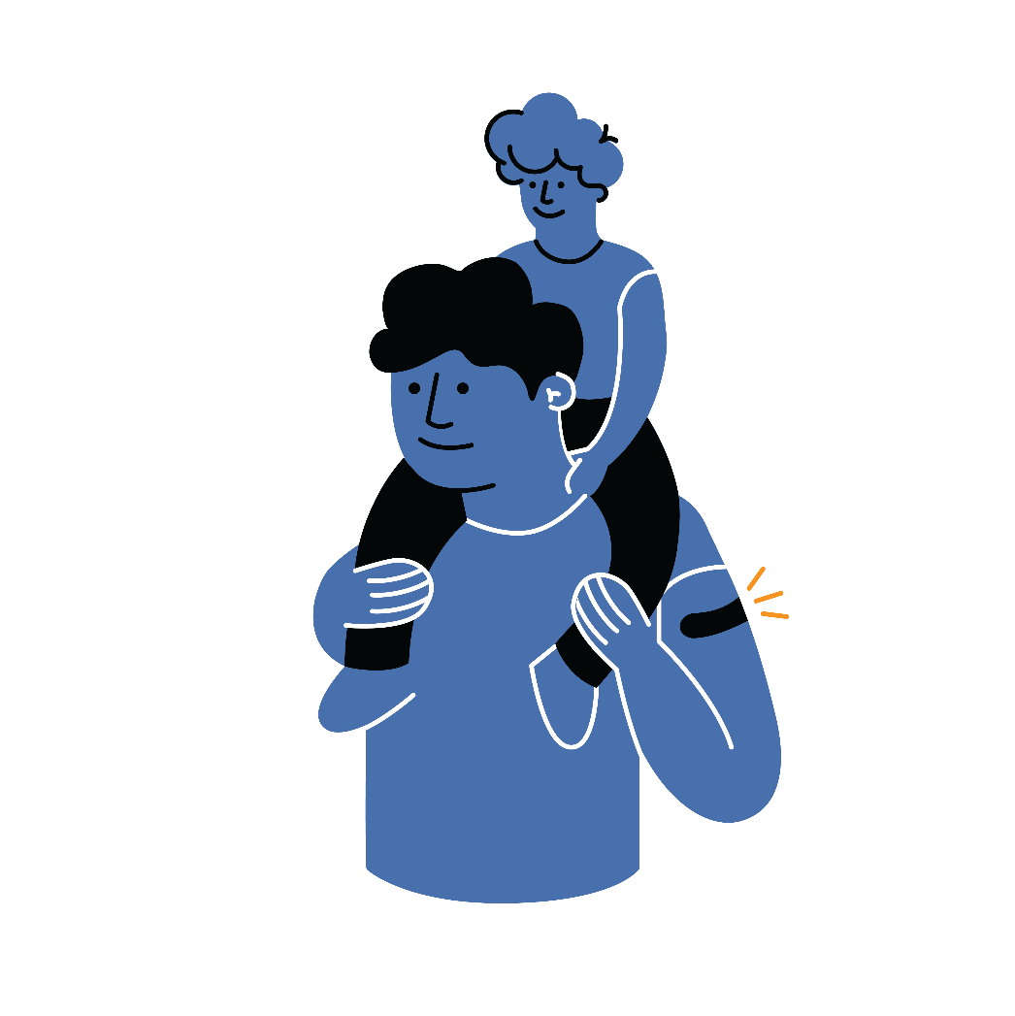
Protect yourself, your family, friends, coworkers, and your community.
Get vaccinated.
COVID-19 and Vaccine Basics
Choose to get vaccinated when it is offered.
Participate in v-safe and help CDC monitor for any health effects after vaccination.
Share your experience with coworkers, friends, and family.
Know the basics about the COVID-19 vaccine.
Help answer questions from your family and friends.
Show you received the vaccine by wearing a sticker
or button prominently.
Notes:
COVID-19 vaccination can protect you, your family, your friends, and your community. Choose to get vaccinated. Participate in v-safe and help CDC monitor for any health effects after vaccination. Share your experience with your coworkers, friends, and family. And visibly show that you received a vaccine by wearing a sticker or button. You have a role in increasing confidence in COVID-19 vaccination and sharing your experience may influence those you care about.

Slide 13
A closer look at vaccine development

Slide 14




Safety of COVID-19 vaccines is a top priority
COVID-19 and Vaccine Basics
COVID-19 vaccines are being held to the same safety standards as all vaccines.
Before Authorization
After Authorization
ACIP
FDA carefully reviews all safety data from clinical trials.
ACIP reviews all safety data before recommending use.
FDA and CDC closely monitor vaccine safety and side effects. There are systems in place that allow CDC and FDA to watch for safety issues.
V-safe: https://www.cdc.gov/coronavirus/2019-ncov/vaccines/safety/vsafe.html
Notes:
COVID-19 vaccines are being held to the same safety standards as other routine vaccines. Several expert and independent groups evaluate the safety of vaccines being given to people in the United States.
Before ANY vaccines receive authorization or approval, the Federal Drug Administration (FDA) carefully reviews all the safety data from clinical trials. And the Advisory Committee on Immunization Practices, or ACIP, which is an independent body of experts, reviews all safety data before recommending use. FDA and ACIP have qualified scientific and clinical experts with minimal conflicts of interest reviewing all of the data.
After ANY vaccines are authorized and in use, both FDA and CDC continue to monitor their safety.
Existing systems can rapidly detect possible vaccine safety problems. These systems are being scaled up for COVID-19 vaccine introduction to fully meet the needs of the nation. Additional systems and data sources are also being developed to further enhance safety monitoring capabilities.
There are systems in place that allow CDC and FDA to watch for safety issues:
CDC: V-safe — A new smartphone-based, after-vaccination health checker for people who receive COVID-19 vaccines. V-safe uses text messaging and web surveys from CDC to check in with vaccine recipients following COVID-19 vaccination. V-safe also provides second vaccine dose reminders if needed, and telephone follow up to anyone who reports medically significant (important) adverse events.
CDC and FDA: Vaccine Adverse Event Reporting System (VAERS) — The national system that collects reports from healthcare professionals, vaccine manufacturers, and the public of adverse events that happen after vaccination; reports of adverse events that are unexpected, appear to happen more often than expected, or have unusual patterns are followed up with specific studies.

Slide 15
COVID-19 vaccines received FDA Emergency Use Authorizations (EUAs)
COVID-19 and Vaccine Basics
Approved Vaccines | Dosing requirements | Eligible ages
Pfizer/BioNTech (BNT162b2) | Two doses given at least 21 days apart | Ages 16+
Moderna (mRNA-1273) | Two doses given at least 28 days apart | Ages 18+
Testing and safety standards:
Prior to approval, each vaccine was tested in tens of thousands of adults from diverse backgrounds, including older adults and communities of color.
Clinical trial data show that both vaccines are safe and effective at preventing COVID-19.
It is unknown how long protection from vaccines might last.
Sources: pfizer.com/news/press-release/press-release-detail/pfizer-and-biontech-conclude-phase-3-study-covid-19-vaccine
investors.modernatx.com/news-releases/news-release-details/modernas-covid-19-vaccine-candidate-meets-its-primary-efficacy
Notes:
COVID-19 vaccines are being held to the same safety standards as other routine vaccines. Several expert and independent groups evaluate the safety of vaccines being given to people in the United States.
Before ANY vaccines receive authorization or approval, the Federal Drug Administration (FDA) carefully reviews all the safety data from clinical trials. And the Advisory Committee on Immunization Practices, or ACIP, which is an independent body of experts, reviews all safety data before recommending use. FDA and ACIP have qualified scientific and clinical experts with minimal conflicts of interest reviewing all of the data.
After ANY vaccines are authorized and in use, both FDA and CDC continue to monitor their safety.
Existing systems can rapidly detect possible vaccine safety problems. These systems are being scaled up for COVID-19 vaccine introduction to fully meet the needs of the nation. Additional systems and data sources are also being developed to further enhance safety monitoring capabilities.
There are systems in place that allow CDC and FDA to watch for safety issues:
CDC: V-safe — A new smartphone-based, after-vaccination health checker for people who receive COVID-19 vaccines. V-safe uses text messaging and web surveys from CDC to check in with vaccine recipients following COVID-19 vaccination. V-safe also provides second vaccine dose reminders if needed, and telephone follow up to anyone who reports medically significant (important) adverse events.
CDC and FDA: Vaccine Adverse Event Reporting System (VAERS) — The national system that collects reports from healthcare professionals, vaccine manufacturers, and the public of adverse events that happen after vaccination; reports of adverse events that are unexpected, appear to happen more often than expected, or have unusual patterns are followed up with specific studies.

Slide 16
These COVID-19 vaccines are mRNA vaccines
COVID-19 and Vaccine Basics
mRNA vaccines teach our cells how to make a harmless piece of the
“spike protein” for SARS-CoV-2.
  After the protein piece is made, the cell breaks down the instructions (the mRNA) and
  gets rid of them.
Cells display this piece of spike protein on their surface, and an immune response is triggered inside our bodies. This produces antibodies to protect us from getting infected if the SARS-CoV-2 virus enters our bodies.
mRNA vaccines do not use the live virus that causes COVID-19. They CANNOT give someone COVID-19.
mRNA vaccines DO NOT affect or interact with our DNA in any way.
Source: Understanding and Explaining mRNA COVID-19 Vaccines | CDC
Notes:
COVID-19 vaccines are being held to the same safety standards as other routine vaccines. Several expert and independent groups evaluate the safety of vaccines being given to people in the United States.
Before ANY vaccines receive authorization or approval, the Federal Drug Administration (FDA) carefully reviews all the safety data from clinical trials. And the Advisory Committee on Immunization Practices, or ACIP, which is an independent body of experts, reviews all safety data before recommending use. FDA and ACIP have qualified scientific and clinical experts with minimal conflicts of interest reviewing all of the data.
After ANY vaccines are authorized and in use, both FDA and CDC continue to monitor their safety.
Existing systems can rapidly detect possible vaccine safety problems. These systems are being scaled up for COVID-19 vaccine introduction to fully meet the needs of the nation. Additional systems and data sources are also being developed to further enhance safety monitoring capabilities.
There are systems in place that allow CDC and FDA to watch for safety issues:
CDC: V-safe — A new smartphone-based, after-vaccination health checker for people who receive COVID-19 vaccines. V-safe uses text messaging and web surveys from CDC to check in with vaccine recipients following COVID-19 vaccination. V-safe also provides second vaccine dose reminders if needed, and telephone follow up to anyone who reports medically significant (important) adverse events.
CDC and FDA: Vaccine Adverse Event Reporting System (VAERS) — The national system that collects reports from healthcare professionals, vaccine manufacturers, and the public of adverse events that happen after vaccination; reports of adverse events that are unexpected, appear to happen more often than expected, or have unusual patterns are followed up with specific studies.

Slide 17
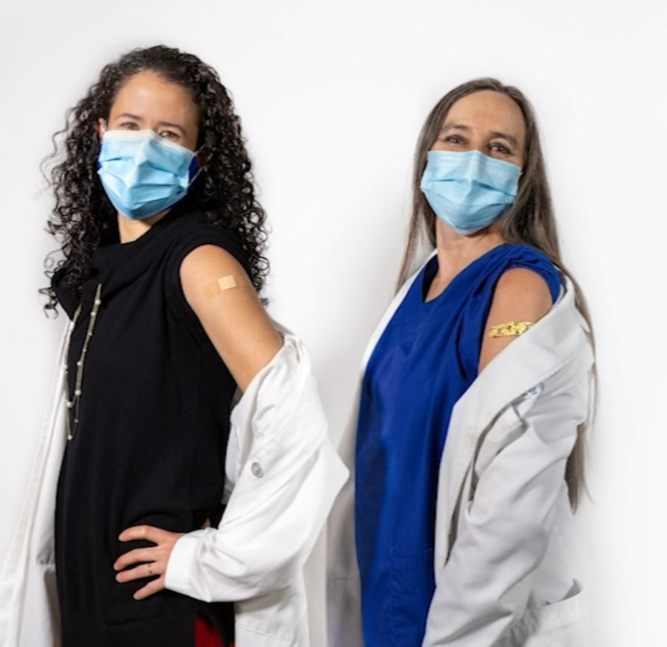
COVID-19 vaccination helps protect you from COVID-19
COVID-19 and Vaccine Basics
Getting a COVID-19 vaccine:
  Will help create an immune response in your body against the virus.
  May help keep you from getting severely ill, even if you do get COVID-19.
  Can protect your family, friends and community
Source: Understanding and Explaining mRNA COVID-19 Vaccines | CDC
Notes:
COVID-19 vaccines are being held to the same safety standards as other routine vaccines. Several expert and independent groups evaluate the safety of vaccines being given to people in the United States.
Before ANY vaccines receive authorization or approval, the Federal Drug Administration (FDA) carefully reviews all the safety data from clinical trials. And the Advisory Committee on Immunization Practices, or ACIP, which is an independent body of experts, reviews all safety data before recommending use. FDA and ACIP have qualified scientific and clinical experts with minimal conflicts of interest reviewing all of the data.
After ANY vaccines are authorized and in use, both FDA and CDC continue to monitor their safety.
Existing systems can rapidly detect possible vaccine safety problems. These systems are being scaled up for COVID-19 vaccine introduction to fully meet the needs of the nation. Additional systems and data sources are also being developed to further enhance safety monitoring capabilities.
There are systems in place that allow CDC and FDA to watch for safety issues:
CDC: V-safe — A new smartphone-based, after-vaccination health checker for people who receive COVID-19 vaccines. V-safe uses text messaging and web surveys from CDC to check in with vaccine recipients following COVID-19 vaccination. V-safe also provides second vaccine dose reminders if needed, and telephone follow up to anyone who reports medically significant (important) adverse events.
CDC and FDA: Vaccine Adverse Event Reporting System (VAERS) — The national system that collects reports from healthcare professionals, vaccine manufacturers, and the public of adverse events that happen after vaccination; reports of adverse events that are unexpected, appear to happen more often than expected, or have unusual patterns are followed up with specific studies.

Slide 18
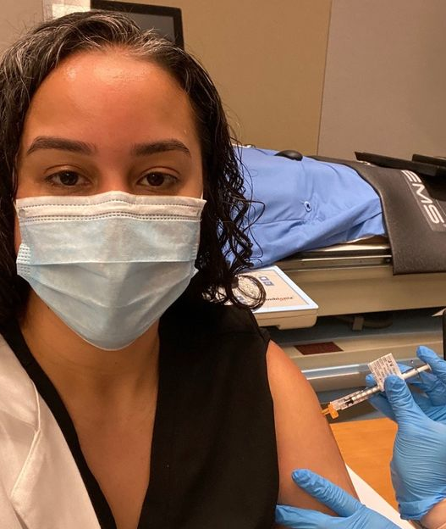
About the COVID-19 mRNA vaccines
COVID-19 and Vaccine Basics
These mRNA vaccines are may produce side effects after vaccination, especially after the second dose.​
Side effects may include: ​
    Fever​
    Headache​
    Muscle aches​
    Rare allergic reactions
No significant safety concerns were identified during the clinical trials.​
At least eight weeks of safety data were gathered during the trials. It is unusual for side effects to appear more than eight weeks after vaccination.
Source: cdc.gov/vaccines/hcp/acip-recs/vacc-specific/covid-19/clinical-considerations.html
Notes:
COVID-19 vaccines are being held to the same safety standards as other routine vaccines. Several expert and independent groups evaluate the safety of vaccines being given to people in the United States.
Before ANY vaccines receive authorization or approval, the Federal Drug Administration (FDA) carefully reviews all the safety data from clinical trials. And the Advisory Committee on Immunization Practices, or ACIP, which is an independent body of experts, reviews all safety data before recommending use. FDA and ACIP have qualified scientific and clinical experts with minimal conflicts of interest reviewing all of the data.
After ANY vaccines are authorized and in use, both FDA and CDC continue to monitor their safety.
Existing systems can rapidly detect possible vaccine safety problems. These systems are being scaled up for COVID-19 vaccine introduction to fully meet the needs of the nation. Additional systems and data sources are also being developed to further enhance safety monitoring capabilities.
There are systems in place that allow CDC and FDA to watch for safety issues:
CDC: V-safe — A new smartphone-based, after-vaccination health checker for people who receive COVID-19 vaccines. V-safe uses text messaging and web surveys from CDC to check in with vaccine recipients following COVID-19 vaccination. V-safe also provides second vaccine dose reminders if needed, and telephone follow up to anyone who reports medically significant (important) adverse events.
CDC and FDA: Vaccine Adverse Event Reporting System (VAERS) — The national system that collects reports from healthcare professionals, vaccine manufacturers, and the public of adverse events that happen after vaccination; reports of adverse events that are unexpected, appear to happen more often than expected, or have unusual patterns are followed up with specific studies.

Slide 19
Fast-tracking COVID-19 vaccines while ensuring safety
COVID-19 and Vaccine Basics
Researchers used existing networks to conduct COVID-19 vaccine trials.
Manufacturing began while clinical trials were still underway. Normally, manufacturing doesn’t begin until trials are completed.
mRNA vaccines are faster to produce than traditional vaccines.
The FDA and the CDC are prioritizing the review and authorization of
COVID-19 vaccines.
*For more information, visit the COVID-19 Prevention Network: coronaviruspreventionnetwork.org/about-covpn
Notes:
COVID-19 vaccines are being held to the same safety standards as other routine vaccines. Several expert and independent groups evaluate the safety of vaccines being given to people in the United States.
Before ANY vaccines receive authorization or approval, the Federal Drug Administration (FDA) carefully reviews all the safety data from clinical trials. And the Advisory Committee on Immunization Practices, or ACIP, which is an independent body of experts, reviews all safety data before recommending use. FDA and ACIP have qualified scientific and clinical experts with minimal conflicts of interest reviewing all of the data.
After ANY vaccines are authorized and in use, both FDA and CDC continue to monitor their safety.
Existing systems can rapidly detect possible vaccine safety problems. These systems are being scaled up for COVID-19 vaccine introduction to fully meet the needs of the nation. Additional systems and data sources are also being developed to further enhance safety monitoring capabilities.
There are systems in place that allow CDC and FDA to watch for safety issues:
CDC: V-safe — A new smartphone-based, after-vaccination health checker for people who receive COVID-19 vaccines. V-safe uses text messaging and web surveys from CDC to check in with vaccine recipients following COVID-19 vaccination. V-safe also provides second vaccine dose reminders if needed, and telephone follow up to anyone who reports medically significant (important) adverse events.
CDC and FDA: Vaccine Adverse Event Reporting System (VAERS) — The national system that collects reports from healthcare professionals, vaccine manufacturers, and the public of adverse events that happen after vaccination; reports of adverse events that are unexpected, appear to happen more often than expected, or have unusual patterns are followed up with specific studies.

Slide 20

Monitoring vaccine safety is a regular, ongoing part of vaccine development
COVID-19 and Vaccine Basics
Existing systems and data sources are used to monitor safety of vaccines after they are authorized or licensed, such as:
  Vaccine Adverse Event Reporting System (VAERS)
  Vaccine Safety Datalink (VSD)
New systems are being developed to monitor vaccine safety, such as v-safe:
  Active surveillance that uses text messaging to initiate web-based survey monitoring.
  Any clinically important events reported by a participant would be sent to VAERS for follow-up.
Notes:
COVID-19 vaccines are being held to the same safety standards as other routine vaccines. Several expert and independent groups evaluate the safety of vaccines being given to people in the United States.
Before ANY vaccines receive authorization or approval, the Federal Drug Administration (FDA) carefully reviews all the safety data from clinical trials. And the Advisory Committee on Immunization Practices, or ACIP, which is an independent body of experts, reviews all safety data before recommending use. FDA and ACIP have qualified scientific and clinical experts with minimal conflicts of interest reviewing all of the data.
After ANY vaccines are authorized and in use, both FDA and CDC continue to monitor their safety.
Existing systems can rapidly detect possible vaccine safety problems. These systems are being scaled up for COVID-19 vaccine introduction to fully meet the needs of the nation. Additional systems and data sources are also being developed to further enhance safety monitoring capabilities.
There are systems in place that allow CDC and FDA to watch for safety issues:
CDC: V-safe — A new smartphone-based, after-vaccination health checker for people who receive COVID-19 vaccines. V-safe uses text messaging and web surveys from CDC to check in with vaccine recipients following COVID-19 vaccination. V-safe also provides second vaccine dose reminders if needed, and telephone follow up to anyone who reports medically significant (important) adverse events.
CDC and FDA: Vaccine Adverse Event Reporting System (VAERS) — The national system that collects reports from healthcare professionals, vaccine manufacturers, and the public of adverse events that happen after vaccination; reports of adverse events that are unexpected, appear to happen more often than expected, or have unusual patterns are followed up with specific studies.

Slide 21
Myth busting: Facts about the vaccine

Slide 22
The facts: COVID-19 mRNA vaccines will not give you COVID-19
COVID-19 and Vaccine Basics
None of the COVID-19 vaccines in use or under development use the live virus that causes COVID-19.
People can experience normal side effects, such as fever, after vaccination. These side effects are signs that the body is building immunity.
It takes a few weeks for the body to build immunity after vaccination. A person could be infected with the virus that causes COVID-19 just before or just after they receive the vaccine and get sick. This is because the vaccine has not had enough time to provide protection.
Notes:
COVID-19 vaccines are being held to the same safety standards as other routine vaccines. Several expert and independent groups evaluate the safety of vaccines being given to people in the United States.
Before ANY vaccines receive authorization or approval, the Federal Drug Administration (FDA) carefully reviews all the safety data from clinical trials. And the Advisory Committee on Immunization Practices, or ACIP, which is an independent body of experts, reviews all safety data before recommending use. FDA and ACIP have qualified scientific and clinical experts with minimal conflicts of interest reviewing all of the data.
After ANY vaccines are authorized and in use, both FDA and CDC continue to monitor their safety.
Existing systems can rapidly detect possible vaccine safety problems. These systems are being scaled up for COVID-19 vaccine introduction to fully meet the needs of the nation. Additional systems and data sources are also being developed to further enhance safety monitoring capabilities.
There are systems in place that allow CDC and FDA to watch for safety issues:
CDC: V-safe — A new smartphone-based, after-vaccination health checker for people who receive COVID-19 vaccines. V-safe uses text messaging and web surveys from CDC to check in with vaccine recipients following COVID-19 vaccination. V-safe also provides second vaccine dose reminders if needed, and telephone follow up to anyone who reports medically significant (important) adverse events.
CDC and FDA: Vaccine Adverse Event Reporting System (VAERS) — The national system that collects reports from healthcare professionals, vaccine manufacturers, and the public of adverse events that happen after vaccination; reports of adverse events that are unexpected, appear to happen more often than expected, or have unusual patterns are followed up with specific studies.

Slide 23
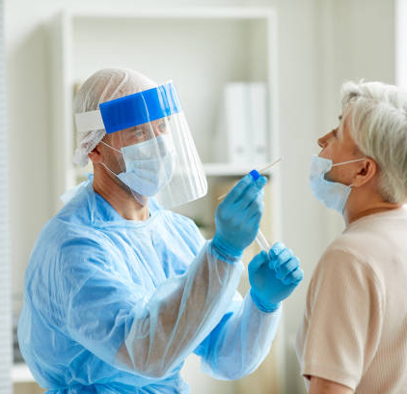
The facts: COVID-19 mRNA vaccines will not cause you to test positive on COVID-19 viral tests
COVID-19 and Vaccine Basics
Vaccines currently authorized for use or in development won’t cause you to test positive on viral tests, which are used to see if you have a current infection.
There is a possibility you may test positive on some antibody tests, which show previous infection. This would indicate that the vaccine may have triggered an immune response in your body and that you may have some level of protection against the virus.
Notes:
COVID-19 vaccines are being held to the same safety standards as other routine vaccines. Several expert and independent groups evaluate the safety of vaccines being given to people in the United States.
Before ANY vaccines receive authorization or approval, the Federal Drug Administration (FDA) carefully reviews all the safety data from clinical trials. And the Advisory Committee on Immunization Practices, or ACIP, which is an independent body of experts, reviews all safety data before recommending use. FDA and ACIP have qualified scientific and clinical experts with minimal conflicts of interest reviewing all of the data.
After ANY vaccines are authorized and in use, both FDA and CDC continue to monitor their safety.
Existing systems can rapidly detect possible vaccine safety problems. These systems are being scaled up for COVID-19 vaccine introduction to fully meet the needs of the nation. Additional systems and data sources are also being developed to further enhance safety monitoring capabilities.
There are systems in place that allow CDC and FDA to watch for safety issues:
CDC: V-safe — A new smartphone-based, after-vaccination health checker for people who receive COVID-19 vaccines. V-safe uses text messaging and web surveys from CDC to check in with vaccine recipients following COVID-19 vaccination. V-safe also provides second vaccine dose reminders if needed, and telephone follow up to anyone who reports medically significant (important) adverse events.
CDC and FDA: Vaccine Adverse Event Reporting System (VAERS) — The national system that collects reports from healthcare professionals, vaccine manufacturers, and the public of adverse events that happen after vaccination; reports of adverse events that are unexpected, appear to happen more often than expected, or have unusual patterns are followed up with specific studies.

Slide 24
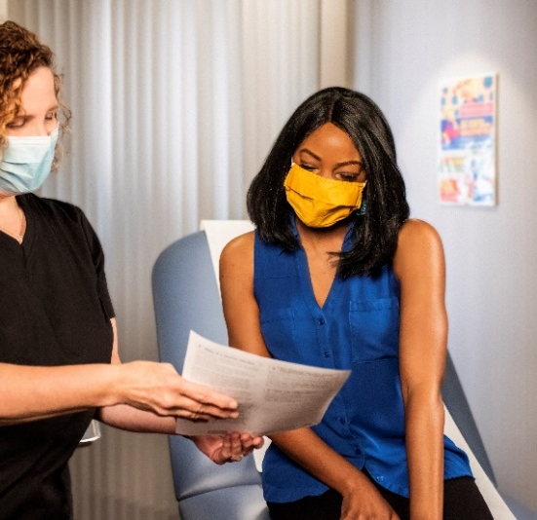
The facts: People who have gotten sick with SARS-CoV-2, the virus that causes COVID-19, may still benefit from vaccination
COVID-19 and Vaccine Basics
People may be advised to get a COVID-19 vaccine even if they have already had the virus, because a person can become infected with the virus more than once.
At this time, experts do not know how long someone is protected from getting sick again after recovering.
Notes:
COVID-19 vaccines are being held to the same safety standards as other routine vaccines. Several expert and independent groups evaluate the safety of vaccines being given to people in the United States.
Before ANY vaccines receive authorization or approval, the Federal Drug Administration (FDA) carefully reviews all the safety data from clinical trials. And the Advisory Committee on Immunization Practices, or ACIP, which is an independent body of experts, reviews all safety data before recommending use. FDA and ACIP have qualified scientific and clinical experts with minimal conflicts of interest reviewing all of the data.
After ANY vaccines are authorized and in use, both FDA and CDC continue to monitor their safety.
Existing systems can rapidly detect possible vaccine safety problems. These systems are being scaled up for COVID-19 vaccine introduction to fully meet the needs of the nation. Additional systems and data sources are also being developed to further enhance safety monitoring capabilities.
There are systems in place that allow CDC and FDA to watch for safety issues:
CDC: V-safe — A new smartphone-based, after-vaccination health checker for people who receive COVID-19 vaccines. V-safe uses text messaging and web surveys from CDC to check in with vaccine recipients following COVID-19 vaccination. V-safe also provides second vaccine dose reminders if needed, and telephone follow up to anyone who reports medically significant (important) adverse events.
CDC and FDA: Vaccine Adverse Event Reporting System (VAERS) — The national system that collects reports from healthcare professionals, vaccine manufacturers, and the public of adverse events that happen after vaccination; reports of adverse events that are unexpected, appear to happen more often than expected, or have unusual patterns are followed up with specific studies.

Slide 25
Other potential concerns
COVID-19 and Vaccine Basics
Was the vaccine produced too quickly? How was it made so fast?
  Once DNA code was discovered for the prominent spike protein – an obvious target for the vaccine — companies manufactured the corresponding mRNA, similar to following the instructions of a LEGO set.
  The vaccine does not require the use of cell culture to grow viral vectors or attenuated viruses, so it is much easier to produce.
It is a new technology, so is it safe?
It is new, but it has some advantages over some other vaccines:
The vaccine does not make whole viruses, so there is no way someone can get COVID from these vaccines.
It does not enter the nucleus or interfere in any way with our own DNA.
Was the vaccine not tested enough?
  Due to the global pandemic, both vaccines were tested in many more people than a typical vaccine trial: The Pfizer vaccine was tested in 43,000 people, and the Moderna vaccine was tested in 30,000 people.
Fact: Receiving an mRNA vaccine will not alter your DNA
  The mRNA from a COVID-19 vaccine never enter the nucleus of the cell, which is where our DNA are kept. This means the mRNA does not affect or interact with our DNA in any way. Instead, COVID-19 vaccines that use mRNA work with the body’s natural defenses to safely develop protection (immunity) to disease.
Notes:
COVID-19 vaccines are being held to the same safety standards as other routine vaccines. Several expert and independent groups evaluate the safety of vaccines being given to people in the United States.
Before ANY vaccines receive authorization or approval, the Federal Drug Administration (FDA) carefully reviews all the safety data from clinical trials. And the Advisory Committee on Immunization Practices, or ACIP, which is an independent body of experts, reviews all safety data before recommending use. FDA and ACIP have qualified scientific and clinical experts with minimal conflicts of interest reviewing all of the data.
After ANY vaccines are authorized and in use, both FDA and CDC continue to monitor their safety.
Existing systems can rapidly detect possible vaccine safety problems. These systems are being scaled up for COVID-19 vaccine introduction to fully meet the needs of the nation. Additional systems and data sources are also being developed to further enhance safety monitoring capabilities.
There are systems in place that allow CDC and FDA to watch for safety issues:
CDC: V-safe — A new smartphone-based, after-vaccination health checker for people who receive COVID-19 vaccines. V-safe uses text messaging and web surveys from CDC to check in with vaccine recipients following COVID-19 vaccination. V-safe also provides second vaccine dose reminders if needed, and telephone follow up to anyone who reports medically significant (important) adverse events.
CDC and FDA: Vaccine Adverse Event Reporting System (VAERS) — The national system that collects reports from healthcare professionals, vaccine manufacturers, and the public of adverse events that happen after vaccination; reports of adverse events that are unexpected, appear to happen more often than expected, or have unusual patterns are followed up with specific studies.

Slide 26
Getting Vaccinated

Slide 27

What to expect before, during, and after COVID-19 vaccination
COVID-19 and Vaccine Basics
Before
During
After
  Learn about COVID-19 vaccines.
  See if COVID-19 vaccination is recommended for you.
  Read the fact sheet that tells you about the specific COVID-19 vaccine you receive.
  Receive a vaccination record card.
  Expect some side effects.
  Enroll in v-safe. V-safe will remind you if you need a second shot.
  Continue using all
  the measures to protect yourself and others.
V-safe: https://www.cdc.gov/coronavirus/2019-ncov/vaccines/safety/vsafe.html
Notes:
Before vaccination, you should learn more about the different types of COVID-19 vaccines and how they work. We’ve provided some of this information in this presentation.
During your vaccination appointment, you should receive a paper or electronic version of a fact sheet specific to the COVID-19 vaccine you are being offered that contains information to help you understand the risks and benefits of receiving that specific vaccine. After you are vaccinated, you should be given a vaccination record card that tells you what COVID-19 vaccine you received, the date you received it, and where you received it.
Your provider may also give you information about how to enroll in v-safe. V-safe is a free, smartphone-based tool that uses text messaging and web surveys to provide personalized health check-ins after you receive a COVID-19 vaccination. This program will help CDC monitor safety of COVID-19 vaccines. Find more information at https://www.cdc.gov/coronavirus/2019-ncov/vaccines/safety/vsafe.html.
Its important to continue using all the tools available to help stop this pandemic. Cover your mouth and nose with a mask when you are around others, stay at least 6 feet away from others, avoid crowds, and wash your hands often.

Slide 28
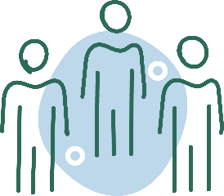
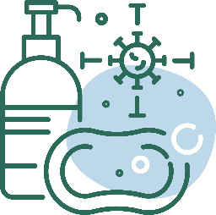
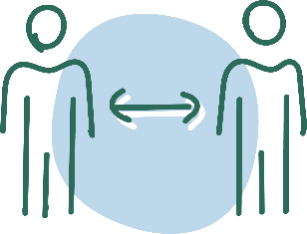

After Vaccination
Getting Vaccinated
Continue COVID-19 prevention measures:
  Cover your nose and mouth with a mask.
  Stay at least 6 feet from people who don’t live with you.
Avoid crowds and poorly ventilated spaces.
Wash your
hands.
Clean and
disinfect frequently touched surfaces.
Enroll in v-safe
If you have questions about your health and vaccination, call your doctor, nurse,
or clinic.
Notes:
If you experience a fever after vaccination, you should stay home from work if you can. Most side effects after vaccination do not last very long. The vaccine does not give you COVID-19. However, you could have been exposed to the virus before you were vaccinated, so if you continue to feel sick, you should consider getting a COVID-19 test. CDC and FDA encourage the public to report possible side effects to the Vaccine Adverse Event Reporting System (VAERS). CDC is also implementing a new smartphone-based tool called v-safe to check in on people’s health after they receive a COVID-19 vaccine. If you enroll in v-safe, you can tell CDC if you have any side effects after getting a COVID-19 vaccine. If you report serious side effects, someone from CDC will call to follow up.

Slide 29
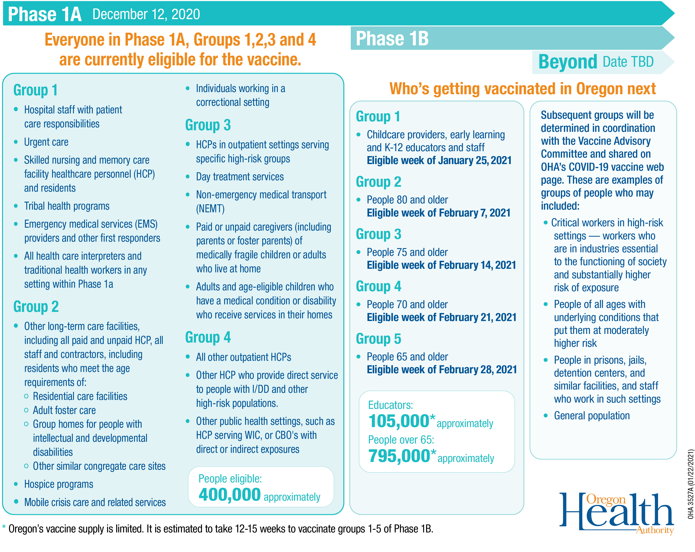

Slide 30
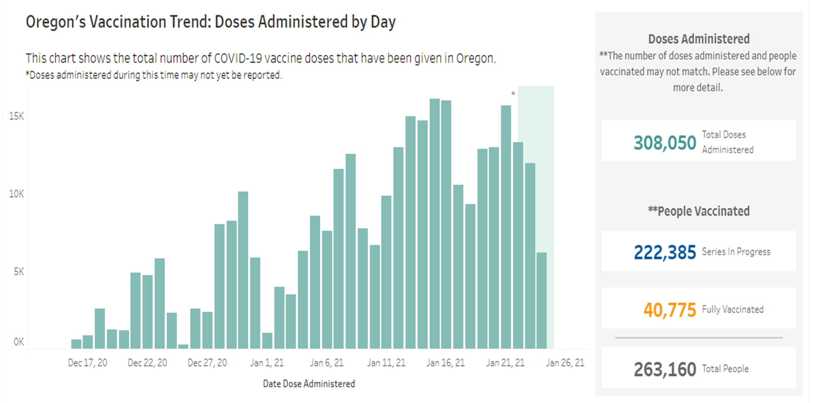
public.tableau.com/profile/oregon.health.authority.covid.19#!/vizhome/OregonCOVID-19VaccinationTrends/OregonStatewideVaccinationTrends

Slide 31
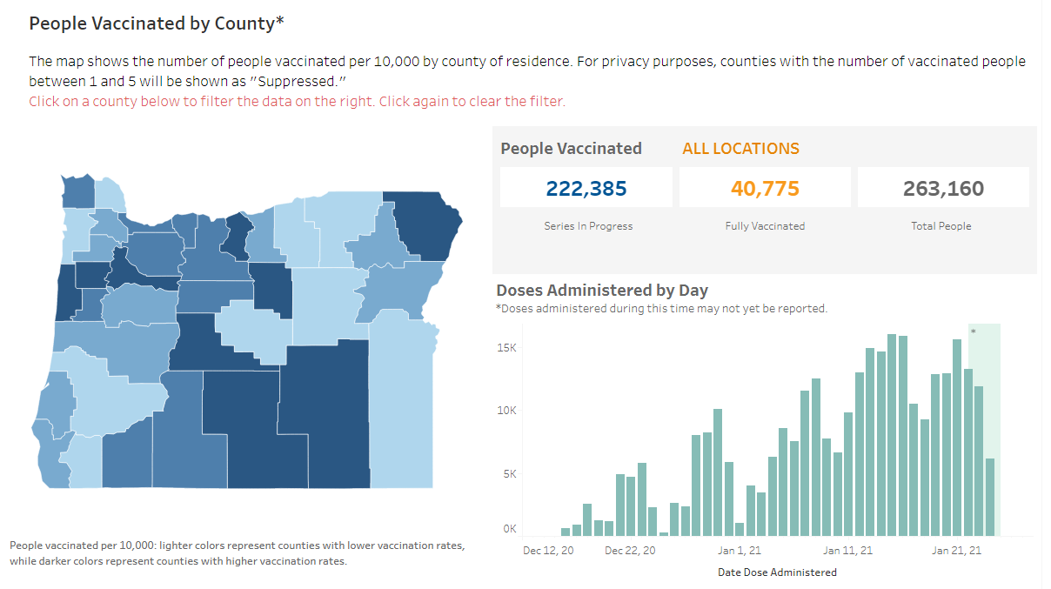
public.tableau.com/profile/oregon.health.authority.covid.19#!/vizhome/OregonCOVID-19VaccinationTrends/OregonStatewideVaccinationTrends

Slide 32
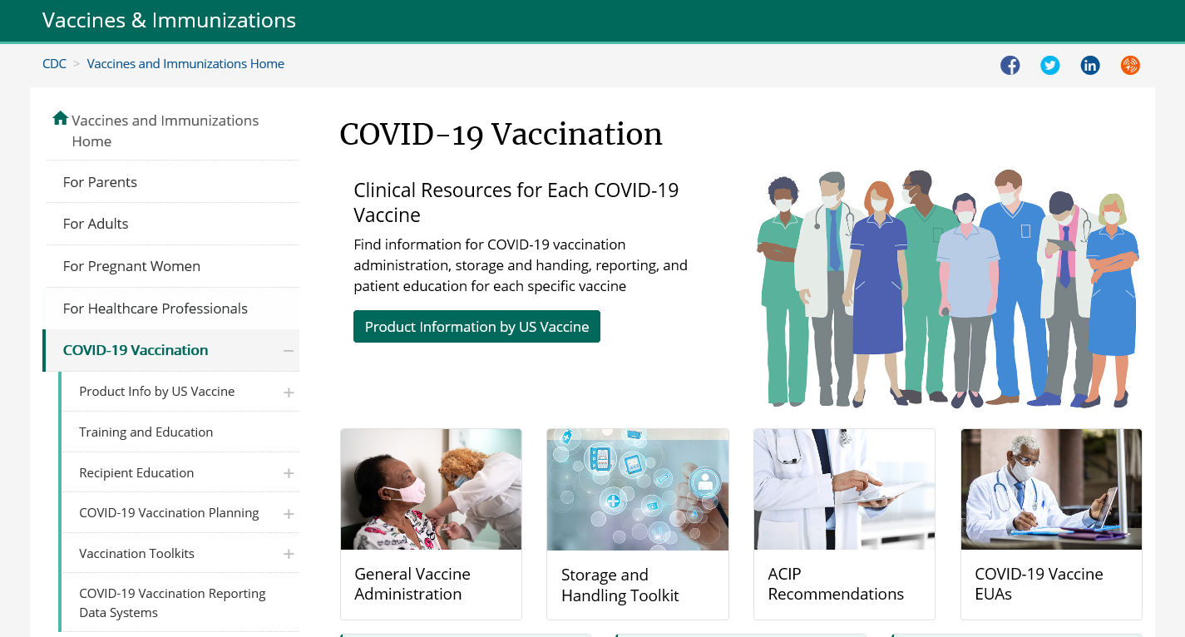
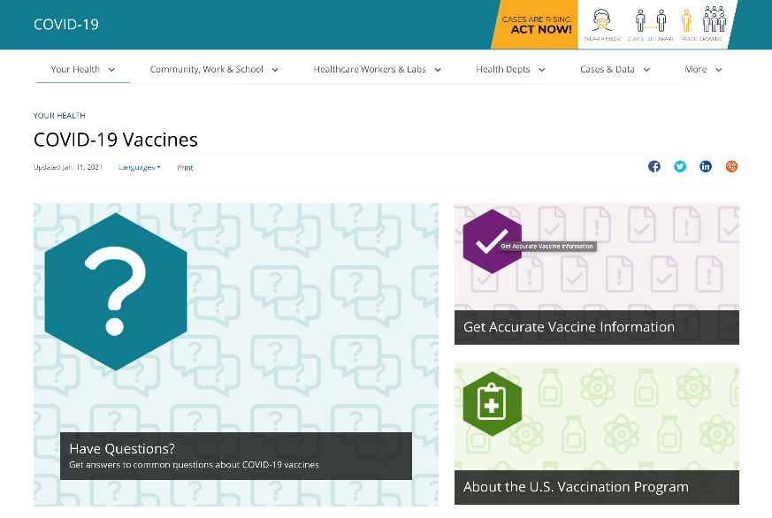
CDC COVID-19 Vaccine Websites
COVID-19 and Vaccine Basics
https://www.cdc.gov/vaccines/covid-19/index.html
https://www.cdc.gov/coronavirus/2019-ncov/vaccines/index.html

Slide 33
Discussion

Slide 34
Answering common patient questions about COVID-19 vaccines
Notes:
Patients will likely have a lot of questions about COVID-19 vaccines. This doesn’t necessarily mean they won’t accept a COVID-19 vaccine. And questions don’t necessarily equal concerns. Sometimes patients simply want your answers to their questions.
Your willingness to listen to their concerns will play a major role in building trust in you and your recommendation. Make it clear that you understand they have questions and you want to answer them, so they feel confident in choosing to get vaccinated.
Seek to understand your patients’ concerns and provide information they need in a way they can understand. Explore some of the vaccine questions patients ask about most and find tips for how to answer their questions: Answering Patient’s Questions.
In the next few slides, I’ll present some common questions with answers on how to respond to them.

Slide 35
Q: How do we know if COVID-19 vaccines are safe?
Explain:
  The FDA carefully reviews all safety data from clinical trials.
  The FDA authorizes emergency vaccine use only when the expected benefits outweigh potential risks.
  ACIP reviews safety data before recommending any vaccine for use.
  The FDA and the CDC will continue to monitor the safety of COVID-19 vaccines to make sure even very rare side effects are identified.
“COVID-19 vaccines were tested in large clinical trials to make sure they meet safety standards. Many people were recruited to participate in these trials to see how the vaccines offer protection to people of different ages, races and ethnicities, as well as those with different medical conditions.”
Notes:
One question you are likely to get is "How do we know if COVID-19 vaccines are safe?"
Explain that:
FDA carefully reviews all safety data from clinical trials.
FDA authorizes emergency vaccine use only when the expected benefits outweigh potential risks.
ACIP reviews safety data before recommending any COVID-19 vaccine for use.
FDA and CDC will continue to monitor the safety of COVID-19 vaccines to make sure even very rare side effects are identified.
For example, you can say:"“COVID-19 vaccines were tested in large clinical trials to make sure they meet safety standards. Many people were recruited to participate in these trials to see how the vaccines offer protection to people of different ages, races, and ethnicities, as well as those with different medical conditions.”

Slide 36
Q: Have these vaccines been tested in people like me?
Probe what they mean by “people like me.”
Explain that the clinical trials recruited a diverse mix of participants.
Share any data you have about the percentages of people included in the trials from communities of color, people with underlying health conditions, and older adults.
Reiterate that no serious safety concerns were identified.
“The first two mRNA vaccines in line for FDA authorization were tested in a diverse group of people. About 30% of U.S. participants were Hispanic, African American, Asian or Native American. About half were older adults. There were no significant safety concerns identified in these or any other groups.”
Notes:
When people ask if the vaccines have been tested in people like them, it’s important to understand that “people like me” could be interpreted many different ways. They may be referring to a subgroup of their racial or ethnic group. Or they may be referring to another group like immigrants, or older adults. Ask probing questions to understand if they are referring to their racial/ethnic group, their age group, their underlying condition or other characteristics.
Explain that the clinical trials recruited a diverse mix of participants.
Share any data you have about the percentages of people from communities of colors, people with underlying health conditions, and older adults included in the trials.
Reiterate that no serious safety concerns were identified.

Slide 37
Q: Is it better to get natural immunity rather than immunity from vaccines?
Explain the potential serious risk COVID-19 poses to them and their loved ones if they get the illness or spread it to others, adding that the disease can be serious even if they are not in a high-risk group.
Explain that scientists are still learning more about the virus that causes COVID-19. It is not known whether getting COVID-19 disease will protect everyone against getting it again or, if it does, how long that protection might last.
“Both this disease and the vaccine are new. We don’t know how long protection lasts for those who get infected or those who are vaccinated. What we do know is that COVID-19 has caused very serious illness and death for a lot of people. If you get COVID-19, you also risk giving it to loved ones who may get sick. Getting a COVID-19 vaccine is a safer choice.”
Notes:
Some patients may ask: "Is it better to get natural immunity rather than immunity from vaccines?"
Explain the potential serious risk COVID-19 poses to them and their loved ones if they get the illness or spread it to others, adding that the disease can be serious even if they are not in a high-risk group.
Explain that scientists are still learning more about the virus that causes COVID-19. And it is not known whether getting COVID-19 disease will protect everyone against getting it again or, if it does, how long that protection might last.
For example, you can say “Both this disease and the vaccine are new. We don’t know how long protection lasts for those who get infected or those who are vaccinated. What we do know is that COVID-19 has caused very serious illness and death for a lot of people. If you get COVID-19, you also risk giving it to loved ones who may get sick. Getting a COVID-19 vaccine is a safer choice.”

Slide 38
Q: Will the shot hurt? Will it make me sick?
What about the side effects?
Explain that they cannot get COVID-19 from the vaccine.
Explain what the most common side effects from vaccination are, how severe they may be, and that they typically go away on their own within a week.
  Make sure patients know that a fever is a potential side effect.
Provide a comparison if it is appropriate for the patient (for example, pain after receiving Shingrix for older adults who have received it).
“These side effects are signs that your immune system is doing exactly what it is supposed to do. It is working and building up protection to disease.”
“Most people do not have serious problems after getting a vaccine. We will understand more about mild side effects of the COVID-19 vaccine before we start to use it. However, your arm may be sore, red or warm to the touch. These symptoms usually go away on their own within a week. Some people report getting a headache, fever, fatigue or body aches after getting a vaccine. “
Notes:
Some people may ask if the shot will hurt, make them sick or have any side effects.
Explain that they cannot get COVID-19 from the vaccine.
Explain what the most common side effects from vaccination are, how severe they may be, and that they typically go away on their own within a week.
Provide a comparison if it is appropriate for the patient (for example, pain after receiving Shingrix for older adults who have received it).
Make sure patients know that a fever is a potential side effect.
You can say "“These side effects are signs that your immune system is doing exactly what it is supposed to do. It is working and building up protection to disease.”
You can then give more detail: “Most people do not have serious problems after getting a vaccine. We will understand more about mild side effects of the COVID-19 vaccine before we start to use it. However, your arm may be sore, red, or warm to the touch. These symptoms usually go away on their own within a week. Some people report getting a headache fever, fatigue, or body aches when getting a vaccine. “

Slide 39
Q: How do we know these vaccines are safe when they are so new? What about long-term side effects?
Explain how the FDA and the CDC are continuing to monitor safety.
Let patients know that ACIP will take action to address any potential safety problems detected.
Compare the potential serious risk of COVID-19 illness with what is currently known about the safety of COVID-19 vaccines.
“COVID-19 vaccines are being tested in large clinical trials to learn more about their safety and effectiveness. However, it does take time and more people getting vaccinated before we can learn about very rare or long-term side effects. That is why safety monitoring will continue. CDC has an independent group of experts that reviews all the safety data as they come in and provides regular safety updates. Any possible problems will be quickly investigated to find out if the issue is related to the COVID-19 vaccine and determine the best course of action.”
Notes:
Others may be more worried about vaccine safety and long-term side effects, given that the vaccines are so new.
Explain how FDA and CDC are continuing to monitor safety.
Let patients know that ACIP will take action to address any potential safety problems detected.
Compare the potential serious risk of COVID-19 illness with what is currently known about the safety of COVID-19 vaccines.
For example, you can say "“COVID-19 vaccines are being tested in large clinical trials to assess their safety and efficacy. However, it does take time and more people getting vaccinated before we learn about very rare or long-term side effects. That is why safety monitoring will continue. CDC has an independent group of experts that reviews all the safety data as they come in and provides regular safety updates. Any possible problems will be quickly investigated to determine if the issue is related to the COVID-19 vaccine and determine the best course of action.”

Slide 40
Q: How many doses are needed and why?
Explain that two shots are needed to provide the best protection against COVID-19 for both mRNA vaccines. The first shot primes the immune system, helping it recognize the virus, and the second shot strengthens the immune response.
Explain that COVID-19 vaccines may differ in the number of doses needed and the spacing between doses.
When applicable, explain the dosing options available in your office and encourage the patient to set up an appointment before they leave to come back for a second dose.
“Nearly all COVID-19 vaccines being studied in the United States require two shots. The first shot starts building protection, but everyone has to come back a few weeks later for the second one to get the most protection the vaccine can offer.”
Notes:
Other people may wonder how many doses are needed and why.
Explain that two shots are needed to provide the best protection against COVID-19 for both mRNA vaccines. The first shot primes the immune system, helping it recognize the virus, and the second shot strengthens the immune response.
Explain that COVID-19 vaccines may differ in the number of doses needed and the spacing between doses.
When applicable, explain the dosing options available in your office and encourage the patient to set up an appointment before they leave to come back for a second dose.
For example, you can say "“Nearly all COVID-19 vaccines being studied in the United States require two shots. The first shot starts building protection, but everyone has to come back a few weeks later for the second one to get the most protection the vaccine can offer.”

Slide 41
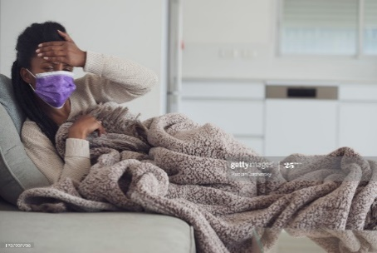
Proactively explain side effects
This is extremely important because:
  New COVID-19 vaccines are reactogenic. They are likely to cause side effects, especially after the second dose.
  Patients may confuse these side effects with COVID-19 or flu symptoms.
  Patients may worry that the vaccine gave them COVID-19.
Things to emphasize:
  Side effects indicate a good immune response.
  Side effects are generally short-lived.
  It is important to return for second dose, even
  if the first dose has unpleasant side effects.
Notes:
If the patient doesn’t ask about side effects, it’s important to mention them before ending the conversation. This is important for any vaccine, but it will be extra important for COVID-19 vaccine because:
As we discussed earlier, new COVID-19 vaccines are reactogenic and likely to cause side effects, especially after the 2nd dose.
Some of these may mimic COVID-19 or flu symptoms, so patients may mistakenly assume they are ill.
Patients may worry that the vaccine gave them COVID-19—we know this is a common myth that has been circulating.
When discussing side effects, be sure to emphasize that:
Side effects are an indication of a good immune response—so while they may be unpleasant, it means the vaccine is doing its job.
Side effects are generally short-lived, and the patient should feel better within a day or two.
It’s very important to return for the second dose for best protection, even if they didn’t feel well after receiving the first dose.

Slide 42
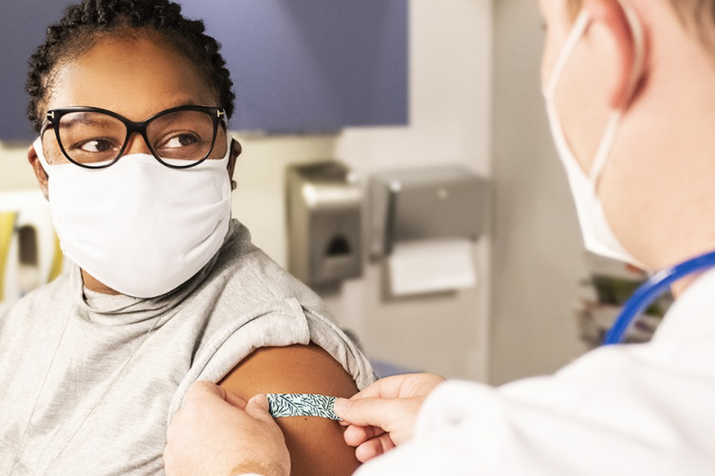
Wrapping up the conversation
Encourage patients to take at least one action.
For example:
  Schedule the second-dose appointment if they got vaccinated that day.
  Read additional information you provide them if they declined vaccination.
If they decline, continue to remind them about the importance of getting a COVID-19 vaccine during future routine visits.
Wrap up the conversation by letting your
patient know that you are open to continuing
the discussion and answering any additional
questions they may have.
Notes:
Once you’ve answered questions and explained side effects, encourage your patients to take at least one action, such as:
Scheduling the second-dose appointment right away if they got vaccinated that day; or
Reading the additional information you provide them about COVID-19 vaccination if they declined vaccination.
If they decline, continue to remind them about the importance of getting a COVID-19 vaccine during future routine visits and wrap up the conversation by letting them know that you are open to continuing the discussion and answering any additional questions they may have.

Slide 43
For more information about COVID-19 and vaccines:
www.cdc.gov/COVID19

